Slide 1
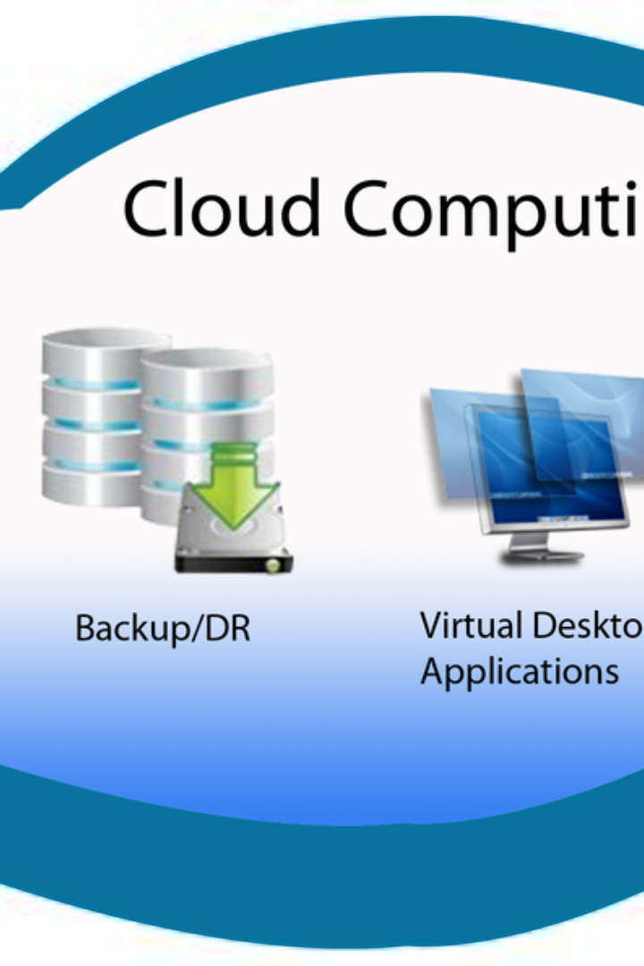
Cloud Forensic Frameworks
Explore the fascinating world of cloud forensic frameworks and learn about their importance in digital investigations. Discover the challenges and the future of cloud forensics.
Presented by: Dhaval Patel
Subject: Cloud Security and Forensics
Class: M.Sc. Cyber security sem – 3
Enroll: 03220030002034
Guided by: Raj K Jaiswal

Slide 2

Introduction to Cloud Forensic Frameworks
1
What are Cloud Forensic Frameworks?
2
Benefits of Cloud Forensic Frameworks
Cloud Forensic Frameworks are structured methodologies used for collecting, analyzing, and preserving digital evidence in cloud environments.
Cloud forensic frameworks provide investigators with systematic approaches to navigate complex cloud infrastructures and uncover critical evidence.
3
Adapting to the Cloud
Traditional forensic techniques need to be modified to handle the unique challenges posed by cloud computing, such as shared resources and virtualized environments.

Slide 3

Importance of Cloud Forensics
1
Data Security & Privacy
2
Incident Response & Investigation
Cloud forensics helps ensure the security and privacy of user data in cloud environments.
Cloud forensic frameworks enable effective incident response and thorough investigations in cases involving cloud-based platforms.
3
Compliance & Litigation
Cloud forensics plays a crucial role in meeting legal and regulatory requirements in litigation and compliance scenarios.

Slide 4

Types of Cloud Forensic Frameworks
Proactive Frameworks
Reactive Frameworks
Proactively designed frameworks assist in the prevention and early detection of security incidents by implementing best practices and monitoring mechanisms.
Reactive frameworks guide investigators through the post-incident phase, helping them gather evidence, analyze it, and determine the sequence of events.
Hybrid Frameworks
Hybrid frameworks combine proactive and reactive elements, allowing for a comprehensive and versatile approach to cloud forensic investigations.

Slide 5

Cloud Forensic Challenges
1
Evidence Location & Preservation
2
Legal & Jurisdictional Issues
3
Data Synchronization & Integrity
Identifying and preserving relevant evidence stored across multiple cloud service providers poses a significant challenge.
Cloud forensics must navigate complex legal and jurisdictional challenges arising from the global nature of cloud computing.
Ensuring the integrity and synchronization of cloud-stored data during forensic investigations requires specialized approaches.

Slide 6



The Future of Cloud Forensics
Advancements in Technology
Collaboration & Expertise
Security-First Approach
Cross-disciplinary collaboration and specialized forensic expertise will become vital in addressing the unique challenges posed by evolving cloud environments.
A proactive security-first approach, emphasizing rigorous access controls, encryption, and incident response planning, will drive the future of cloud forensic frameworks.
Ongoing technological advancements such as AI-powered analysis and blockchain-based evidence management systems will shape the future of cloud forensics.

Slide 7

Conclusion
Cloud forensic frameworks are essential tools for solving complex digital investigations in cloud environments. To ensure successful outcomes, organizations must embrace best practices and continuously adapt to the evolving world of cloud computing.

Slide 8
Thank You!

